Slide 1
Welcome
Duke of Edinburgh Award
Presentation
12th January 2023

Slide 2
Presenters:
Dr Ruth Smith
DofE Coordinator, RGS
smithr@ripongrammar.com
Mr Michael Stones
Regional DofE

Slide 3
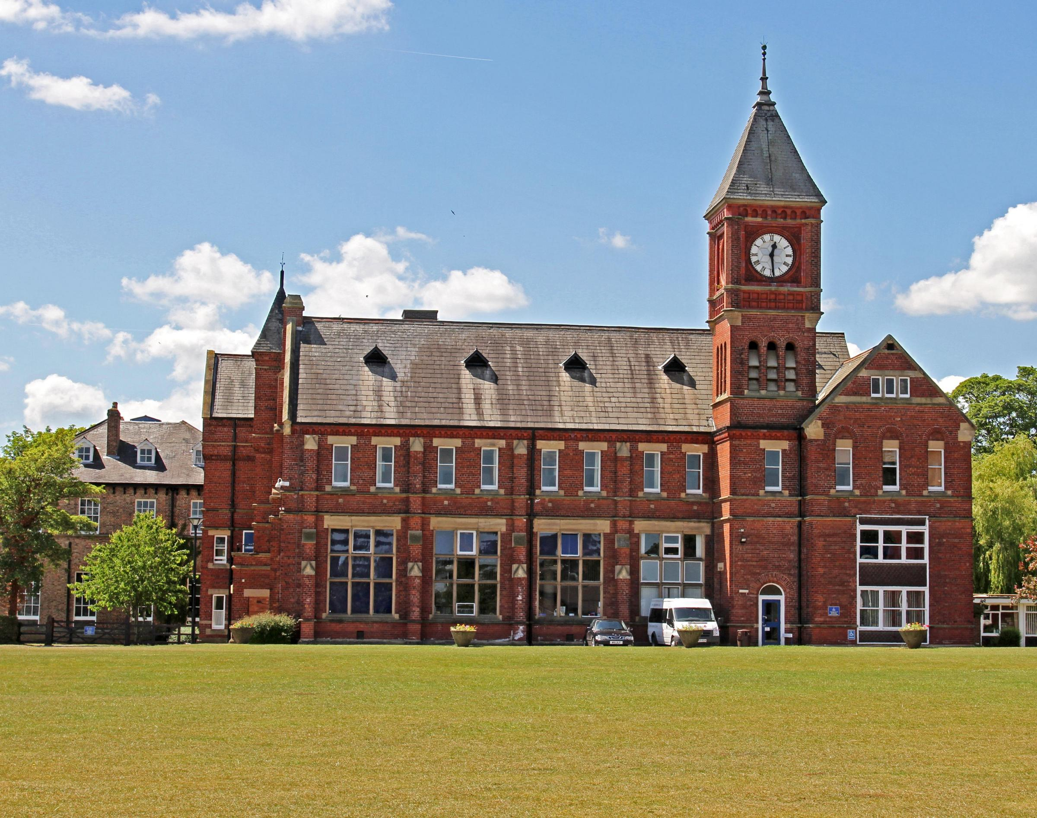
Welcome to DofE 2022-23
Next steps
Check information in letter to parents (9th December)
Check you can make the training and expedition dates!
Fill in the expression of interest form and send to Dr Smith smithr@ripongrammar.com by 20th January

Slide 4
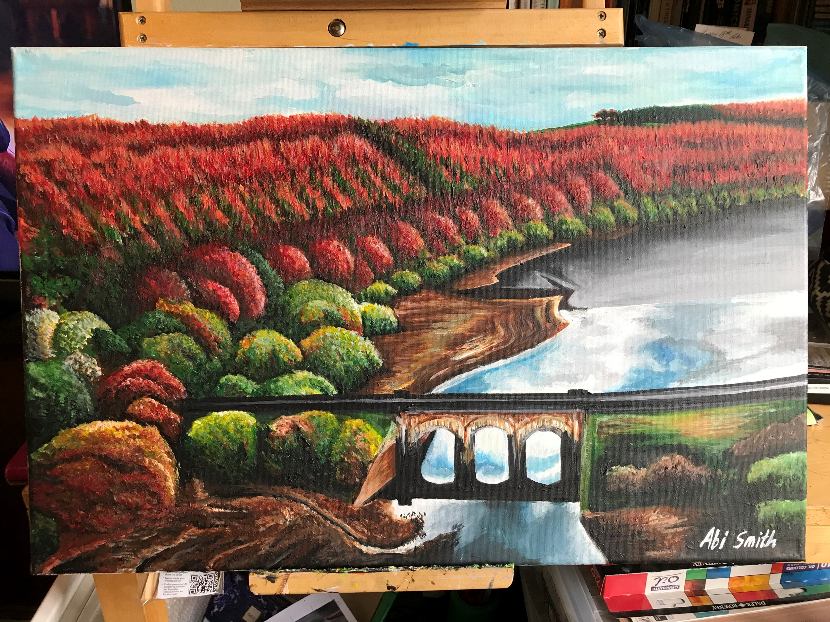
What will happen after that
Letter of acceptance emailed out by 23rd January (includes parentpay details)
Participants will be registered with eDofE: Dr Smith creates account using pupil school email – participant login to activate
Participants can start organising their Skill, Volunteering and Physical

Slide 5
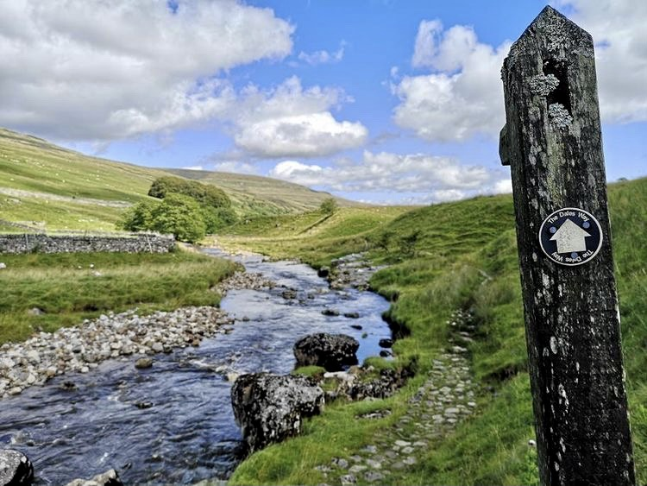
Expeditions
BXM Expeditions parents information session 8th February, 7pm school hall
Training day for all participants Saturday 25th February at RGS (when groups will be organised)
Expeditions start weekend of 31st March/1st April !

Slide 6
Training Day (at RGS) | 25/02/2023
Bronze Practice Cluster 1 | 01/04/23-02/04/23
Bronze Practice Cluster 2 | 13/05/23-14/05/23
Bronze Qualifying Cluster 1 | 03/06/23-04/06/23
Bronze Qualifying Cluster 2 | 15/07/23-16/07/23
Gold Practice | 31/03/23-03/04/23
Gold Qualifying | 23/07/23-27/07/23

Slide 7
Thank you
Any questions…

